Slide 1
Development of derivatized magnetite polysaccharride resins as smart filters in aqueous solution
LANCE SHIPMAN YOUNG, PHD, VINCENT CHESTER, JABEZ BEAZER
MOREHOUSE COLLEGE, ATLANTA, GA

Slide 2
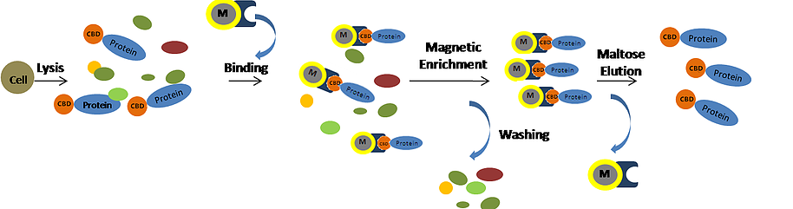
Concept
The use of magnetically separable functional materials has been established for applications like protein purification
For example, chitin magnetite “beads” have been used for the facile purification of engineered proteins containing chitin-binding domains (CBDs)
This concept can be expanded, however, for much wider use as such materials could make for easy-to-use filtration devices and/or solute detectors in aqueous solutions.

Slide 3
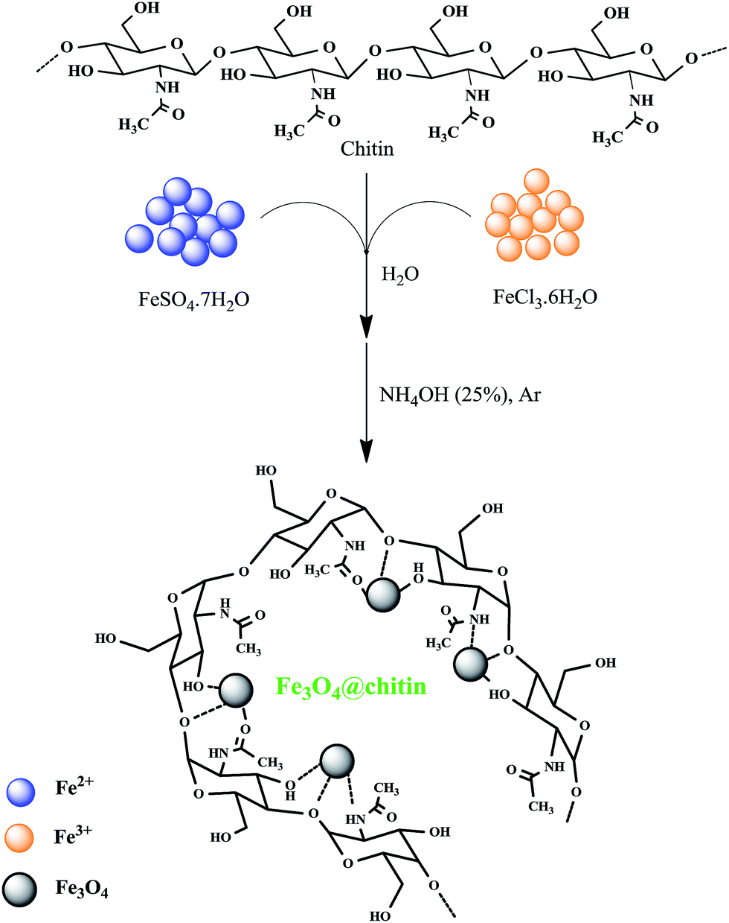
Proposed Work
Our plan is to develop polysaccharide (primarily chitin and/or chitosan) magnetite beads using chemistry previously described
These beads will then be chemically treated to create functional “tethers”, that would attach to the polysaccharide on one end and possess a free functionality on the other.
Beads

Slide 4
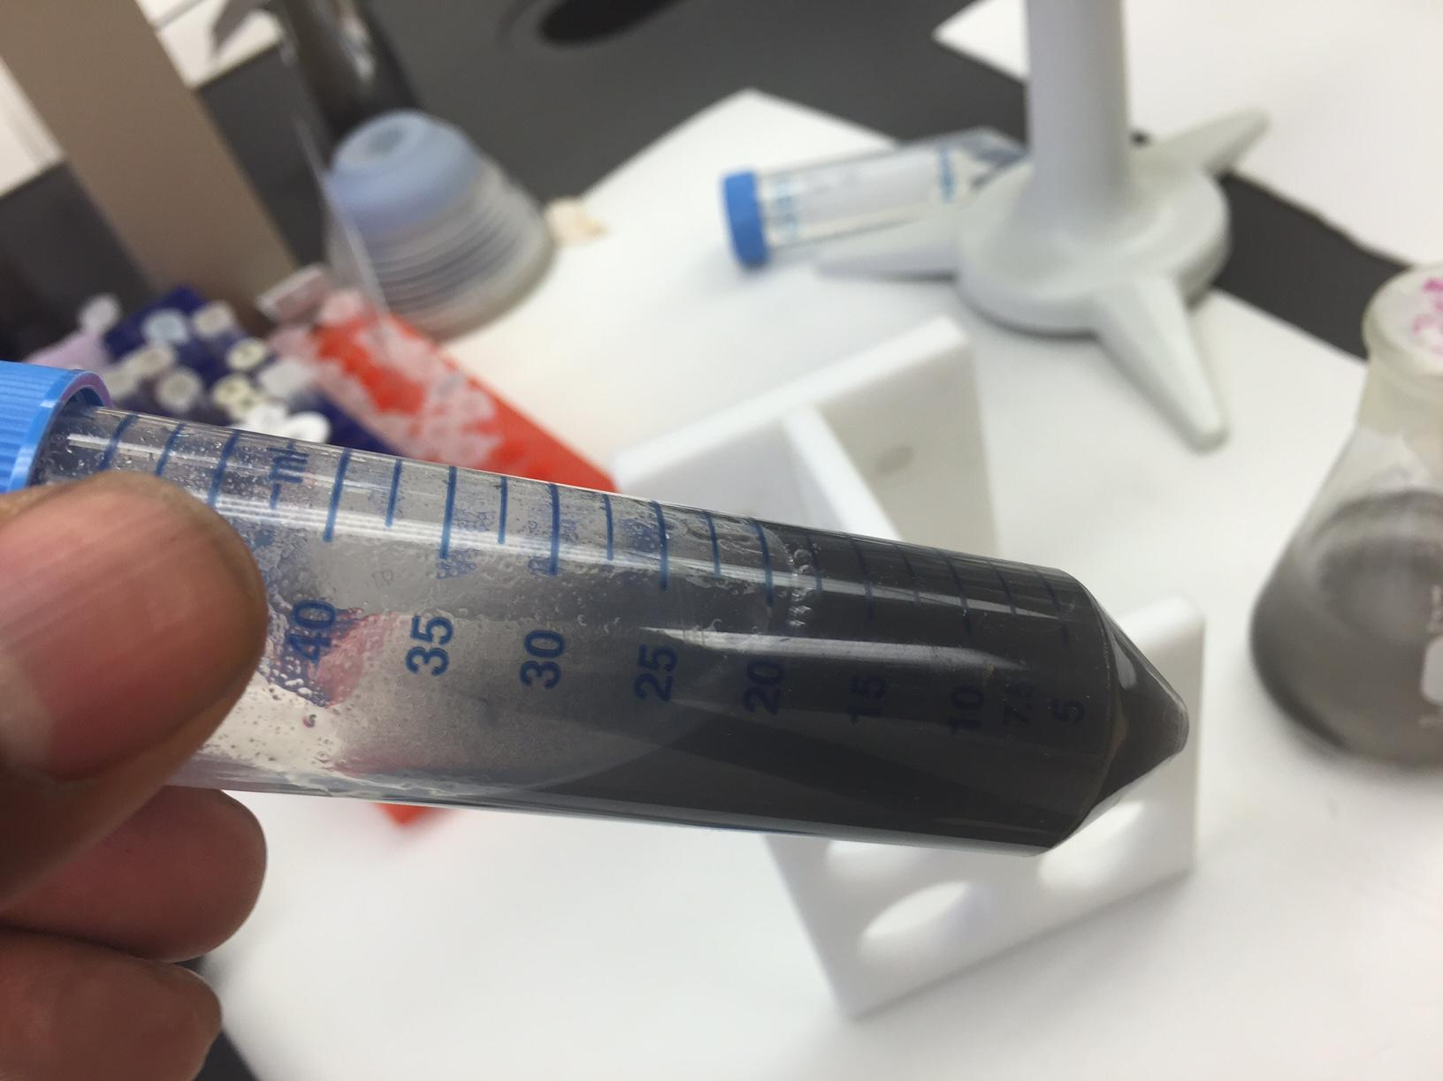
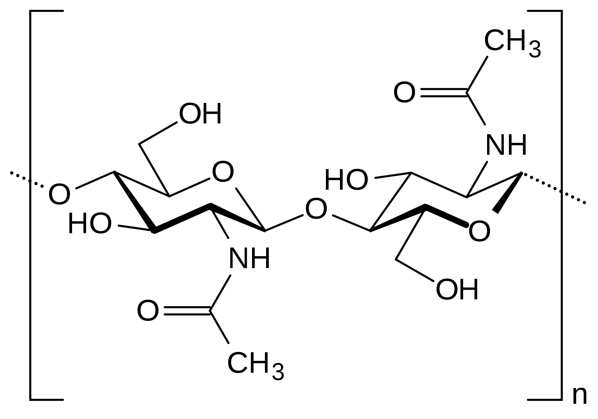
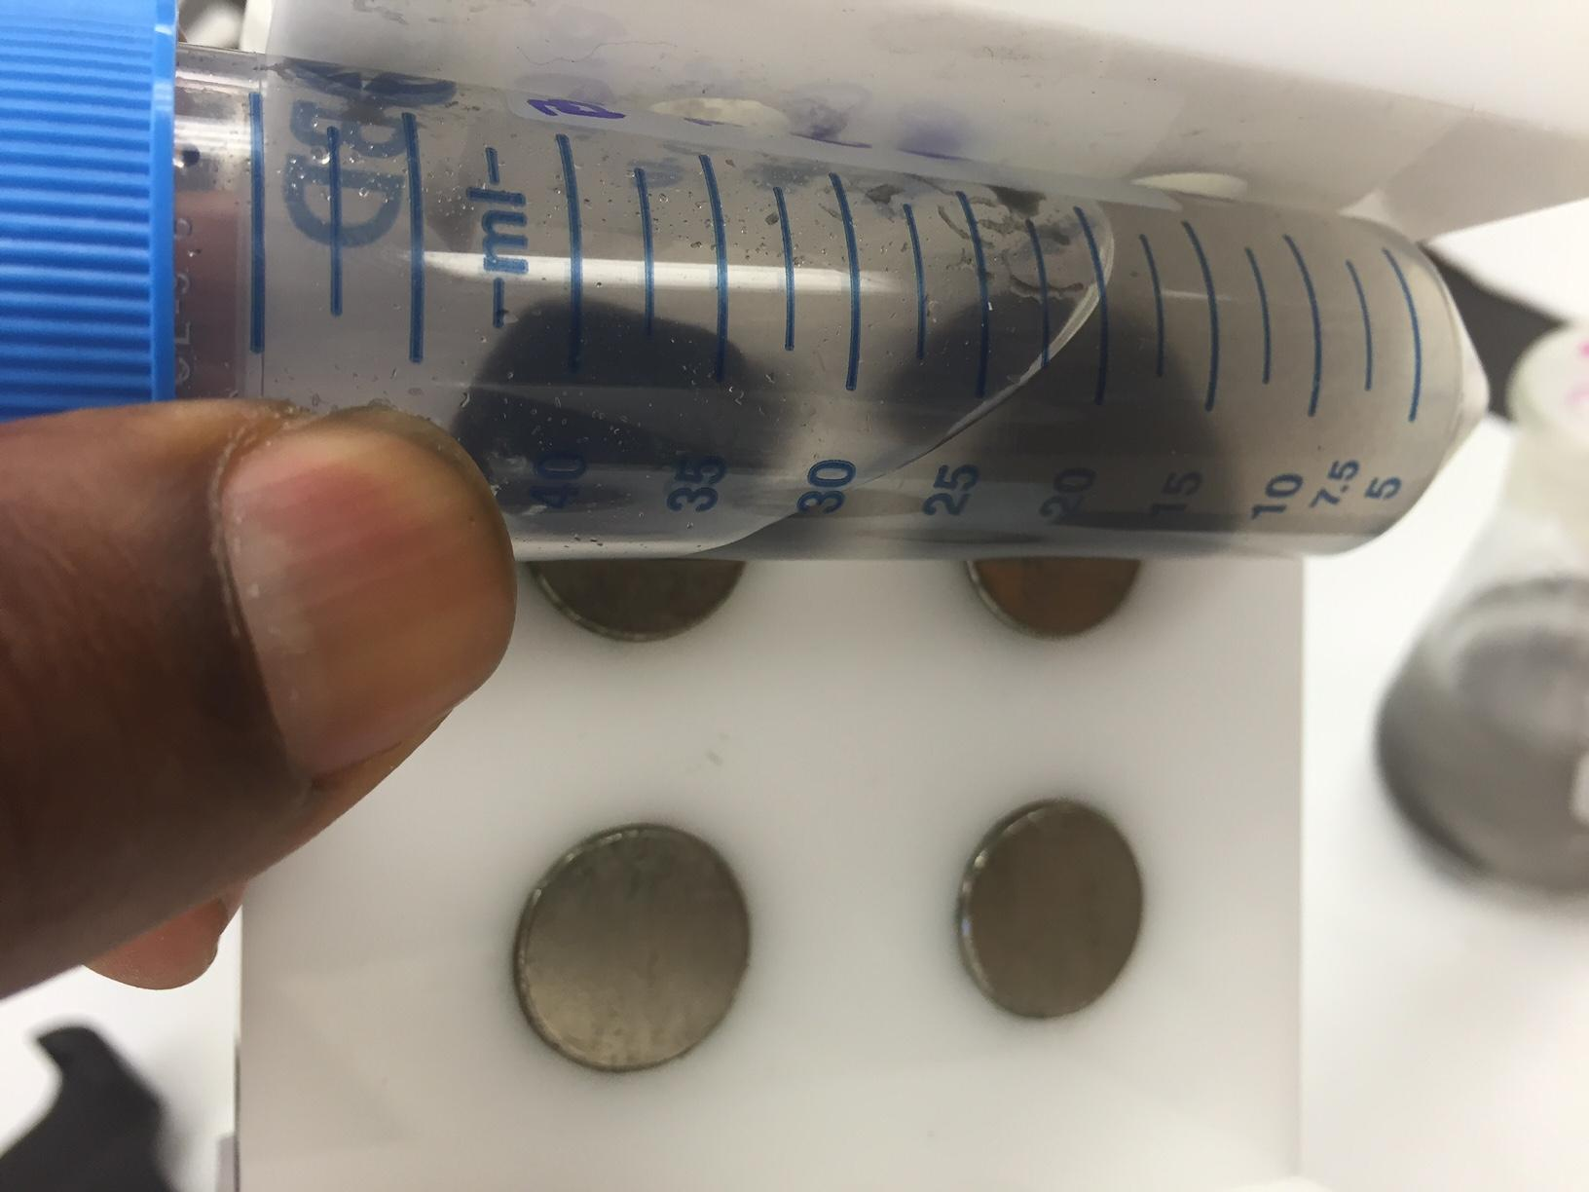
Proposed Work
These functionalities could include:
Heavy metal binding agents
(water purification/remediation)
Microbial detection
Chitin Magnetite Beads
In Aqueous Solution
(before exposure to magnet)
Functional
Linker
Chitin Magnetite Beads
In Aqueous Solution
(after exposure to magnet)
Beads

Slide 5
Proposed Work
These functionalities could include:
Heavy metal binding agents
(water purification/remediation)
Microbial detection and/or removal
Our project will entail creating beads that can selectively extract a pigment from aqueous solution in order to prove the concept
Functional
Linker
In light of recent events in Flint, MI and other areas where water quality and public safety have emerged as concerns, these materials could be very marketable to the public to test the quality of the water supply.

